Slide 1
House-Hold Rental Team-Alpha Project Review 4: FrontEnd Presentation CPSC 5240-01 Software as a Service By, Amogha Lavanya Sravya
An e-commerce website which provides a platform for renting household goods, electronics, fashion items, furniture, art-painting, cars, bikes etc.

Slide 2
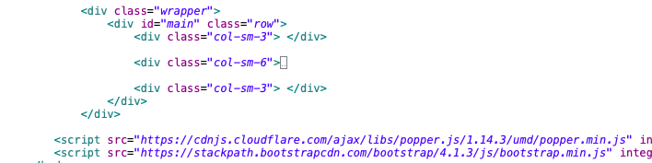
BOOTSTRAP CSS For Web and Mobile applications

Slide 3
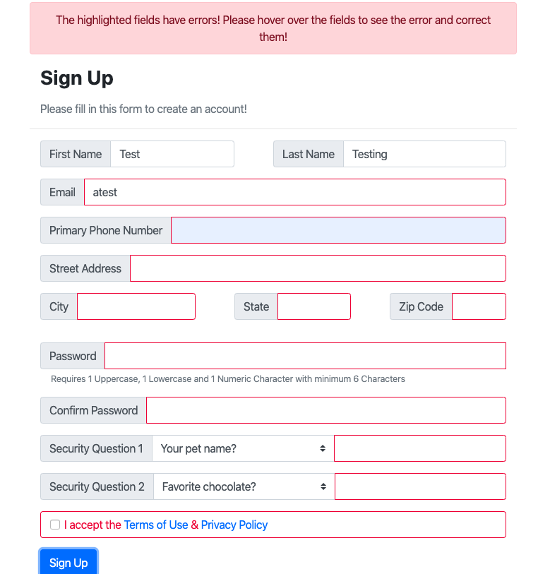
SIGN-UP page – Front-End Validation

Slide 4
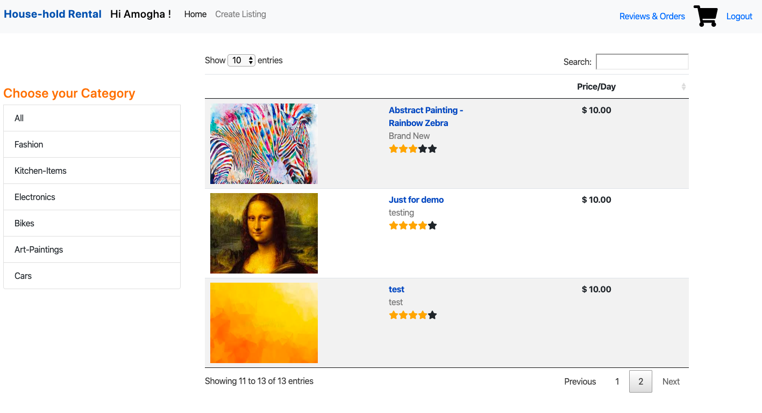
HOME PAGE

